Slide 1
Principles of programming

Slide 2
Output / Print
System.out.println("Hello World!");
System.out.print("Hello World! "); System.out.print("I will print on the same line.");

Slide 3
Formatting With printf()
Specifier | Explanation
%c | Format characters
%d | Format decimal (integer) numbers (base 10)
%e | Format exponential floating-point numbers
%f | Format floating-point numbers
%i | Format integers (base 10)
%o | Format octal numbers (base 8)
%s | Format string of characters
%u | Format unsigned decimal (integer) numbers
%x | Format numbers in hexadecimal (base 16)
%n | add a new line character

Slide 4
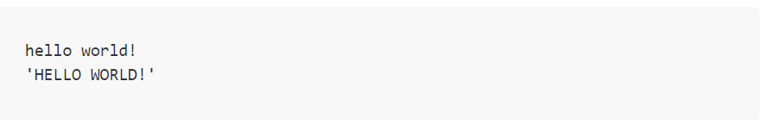
Formatting a string
System.out.printf("%s%n", "hello world!");
System.out.printf("'%S' %n", "hello world!");

Slide 5
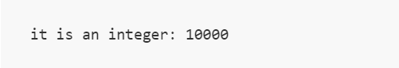
Formatting numbers
System.out.printf("it is an integer: %d%n", 10000);

Slide 6
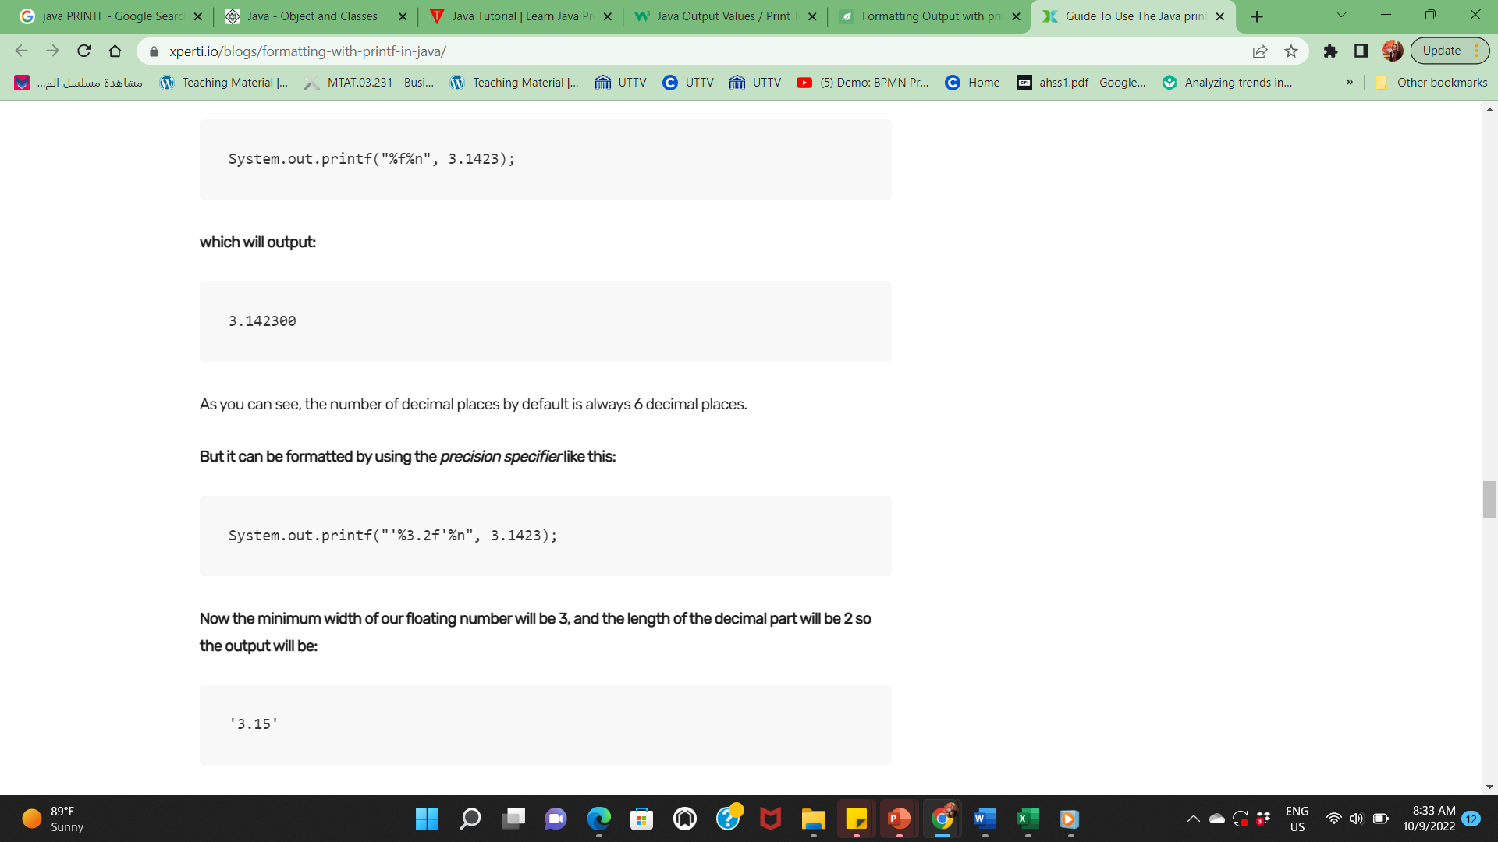
System.out.printf("%f%n", 3.1423);
System.out.printf("'%3.2f'%n", 3.1423);

Slide 7
Comments in Java
public class MyFirstJavaProgram {
/* This is my first java program. * This will print 'Hello World' as the output * This is an example of multi-line comments. */
public static void main(String []args) {
// This is an example of single line comment
/* This is also an example of single line comment. */ System.out.println("Hello World");
}
}

Slide 8
First program
public class MyFirstJavaProgram {
/* This is my first java program. * This will print 'Hello World' as the output */
public static void main(String []args)
{
System.out.println("Hello World"); // prints Hello World
}
}

Slide 9
Ex 1
Write an application that displays the numbers 1 to 4 on the same line,with each pair of adjacent numbers separated by one space. Use the followingtechniques:
a) Use one System.out.println statement.
b) Use four System.out.print statements.
c) Use one System.out.printf statement.

Slide 10
package ch2ex14
public class Ch2Ex14{
// main method begins execution of Java application
public static void main(String[] args){
//a: Use one System.out.println statement to display numbers 1 to 4 on thesame line
System.out.println("1 2 3 4");
//b: Use four System.out.print statements to display numbers 1 to 4 on thesame line
System.out.print("1 ");
System.out.print("2 ");
System.out.print("3 ");
System.out.print("4");
//Blank line to show next part
System.out.println();
//c: Use one System.out.printf statement to display numbers 1 to 4 on thesame line
System.out.printf("%d %d %d %d", 1, 2, 3, 4);
//Blank lineSystem.out.println();}
// end method main
}

Slide 11
Variables
String - stores text, such as "Hello". String values are surrounded by double quotes
int - stores integers (whole numbers), without decimals, such as 123 or -123
float - stores floating point numbers, with decimals, such as 19.99 or -19.99
char - stores single characters, such as 'a' or 'B'. Char values are surrounded by single quotes
boolean - stores values with two states: true or false

Slide 12
Variables cont.,
String name = "John";
System.out.println(name);
int myNum = 15;
System.out.println(myNum);

Slide 13
Variables cont.,
int myNum = 5;
float myFloatNum = 5.99f;
char myLetter = 'D’;
boolean myBool = true;
String myText = "Hello";

Slide 14
User Input (Scanner)
import java.util.Scanner; // Import the Scanner class class Main {
public static void main(String[] args) {
Scanner myObj = new Scanner(System.in); // Create a Scanner object
System.out.println("Enter username");
String userName = myObj.nextLine(); // Read user input System.out.println("Username is: " + userName); // Output user input
}
}

Slide 15
User Input (Scanner) cont.,
nextBoolean() | Reads a boolean value from the user
nextByte() | Reads a byte value from the user
nextDouble() | Reads a double value from the user
nextFloat() | Reads a float value from the user
nextInt() | Reads a int value from the user
nextLine() | Reads a String value from the user

Slide 16
Ex 2
Write an application that asks the user to enter two integers, obtains them from the user and prints their sum, product, difference and quotient (division). Use the techniques shown in Fig. 2.7.

Slide 17
import java.util.Scanner;
public class Calculate
{
public static void main( String args[] ) {
Scanner input = new Scanner( System.in );
int number1; // first number
int number2; // second number
System.out.print( "Enter first integer: " ); // prompt for input
number1 = input.nextInt(); // read first integer
System.out.print( "Enter second integer: " ); // prompt for input
number2 = input.nextInt(); // read second integer
// display results
System.out.printf( "\nSum is %d\n", ( number1 + number2 ) );
System.out.printf( "Product is %d\n", ( number1 * number2 ) );
System.out.printf( "Difference is %d\n", ( number1 - number2 ) );
System.out.printf( "Quotient is %d\n", ( number1 / number2 ) );
} // end main
} // end class Calculate

Slide 18
The if Statement
if (20 > 18) {
System.out.println("20 is greater than 18");
}
int x = 20;
int y = 18;
if (x > y) {
System.out.println("x is greater than y");
}

Slide 19
Conditions and If Statements
Less than: a < b
Less than or equal to: a <= b
Greater than: a > b
Greater than or equal to: a >= b
Equal to a == b
Not Equal to: a != b

Slide 20
Ex 3
Write an application that asks the user to enter two integers, obtains them from the user and displays the larger number followed by the words "is larger". If the numbers are equal, print the message "These numbers are equal." Use the techniques shown in Fig. 2.15.

Slide 21
import java.util.Scanner;
public class Larger
{
public static void main( String args[] )
{
Scanner input = new Scanner( System.in );
int number1; // first number to compare
int number2; // second number to compare
System.out.print( "Enter first integer: " ); // prompt for input
number1 = input.nextInt(); // read first number
System.out.print( "Enter second integer: " ); // prompt for input
number2 = input.nextInt(); // read second number
if ( number1 > number2 )
System.out.printf( "%d is larger\n", number1 );
if ( number1 < number2 )
System.out.printf( "%d is larger\n", number2 );
if ( number1 == number2 )
System.out.println( "These numbers are equal\n" );
} // end main
} // end class Larger

Slide 22
Ex 4
Write an application that inputs three integers from the user and displays the sum, average, product, smallest and largest of the numbers. Use the techniques shown in Fig. 2.15. [Note: The calculation of the average in this exercise should result in an integer representation of the average. So if the sum of the values is 7, the average should be 2, not 2.3333….]

Slide 23
import java.util.Scanner;
public class Calculate2 {
public static void main( String args[] ){
Scanner input = new Scanner( System.in );
int number1; // first number
int number2; // second number
int number3; // third number
int largest; // largest value
int smallest; // smallest value
int sum; // sum of numbers
int product; // product of numbers
int average; // average of numbers
System.out.print( "Enter first integer: " ); // prompt for input
number1 = input.nextInt(); // read first number
System.out.print( "Enter second integer: " ); // prompt for input
number2 = input.nextInt(); // read second number
System.out.print( "Enter third integer: " ); // prompt for input
number3 = input.nextInt(); // read third number
// determine largest value
largest = number1; // assume number1 is the largest

Slide 24
if ( number2 > largest ) // determine whether number2 is larger
largest = number2;
if ( number3 > largest ) // determine whether number3 is larger
largest = number3;
// determine smallest value
smallest = number1; // assume number1 is the smallest
if ( number2 < smallest ) // determine whether number2 is smallest
smallest = number2;
if ( number3 < smallest ) // determine whether number3 is smallest
smallest = number3;
// perform calculations
sum = number1 + number2 + number3;
product = number1 * number2 * number3;
average = sum / 3;
// print results
System.out.printf( "\nFor the numbers %d, %d and %d\n",
number1, number2, number3 );
System.out.printf( "Largest is %d\n", largest );
System.out.printf( "Smallest is %d\n", smallest );
System.out.printf( "Sum is %d\n", sum);
System.out.printf( "Product is %d\n", product );
System.out.printf( "Average is %d\n", average );
} // end main
} // end class Calculate2

Slide 25
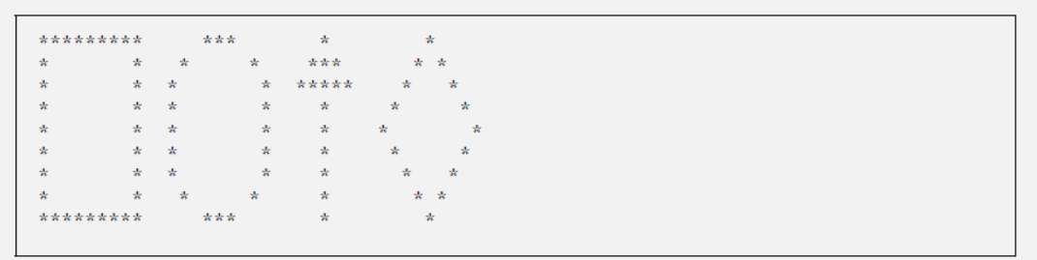
Ex 5
Write an application that displays a box, an oval, an arrow and a diamond using asterisks (*), as follows:

Slide 26
public class Shapes
{
public static void main( String args[] )
{
System.out.println( "********* *** * * " );
System.out.println( "* * * * *** * * " );
System.out.println( "* * * * ***** * * " );
System.out.println( "* * * * * * * " );
System.out.println( "* * * * * * *" );
System.out.println( "* * * * * * * " );
System.out.println( "* * * * * * * " );
System.out.println( "* * * * * * * " );
System.out.println( "********* *** * * " );
} // end main
} // end class Shapes

Slide 27
Ex 6
What does the following code print? System.out.println( "*\n**\n***\n****\n*****" );

Slide 28
*
**
***
****
*****

Slide 29
Ex 7
What does the following code print?
System.out.println( "*" );
System.out.println( "***" );
System.out.println( "*****" );
System.out.println( "****" );
System.out.println( "**" );

Slide 30
*
***
*****
****
**

Slide 31
Ex 8
What does the following code print?
System.out.print( "*" );
System.out.println( "***" );
System.out.println( "*****" );
System.out.print( "****" );
System.out.println( "**" );

Slide 32
***************

Slide 33
Ex 9
What does the following code print?
System.out.print( "*" );
System.out.println( "***" );
System.out.println( "*****" );
System.out.print( "****" );
System.out.println( "**" );

Slide 34
****
*****
******

Slide 35
Ex 10
What does the following code print?
System.out.printf( "%s\n%s\n%s\n", "*", "***", "*****" );

Slide 36
*
***
*****

Slide 37
Ex 11
Write an application that reads five integers, determines and prints the largest and smallest integers in the group. Use only the programming techniques you learned in this chapter.

Slide 38
import java.util.Scanner;
public class LargeSmall
{
public static void main( String args[] )
{
Scanner input = new Scanner( System.in );
// numbers to be entered
int firstNumber;
int secondNumber;
int thirdNumber;
int fourthNumber;
int fifthNumber;
// largest and smallest
int largest;
int smallest;
System.out.print( "Enter first number: " ); // prompt for input
firstNumber = input.nextInt(); // read first number
// initially firstNumber is the smallest and the largest
smallest = firstNumber;
largest = firstNumber;
System.out.print( "Enter second number: " ); // prompt for input
secondNumber = input.nextInt(); // read second number

Slide 39
// determine whether secondNumber is the smallest
if ( secondNumber < smallest )
smallest = secondNumber;
// determine whether secondNumber is the largest
if ( secondNumber > largest )
largest = secondNumber;
System.out.print( "Enter third number: " ); // prompt for input
thirdNumber = input.nextInt(); // read third number
// determine whether thirdNumber is the smallest
if ( thirdNumber < smallest )
smallest = thirdNumber;
// determine whether thirdNumber is the largest
if ( thirdNumber > largest )
largest = thirdNumber;

Slide 40
System.out.print( "Enter fourth number: " ); // prompt for input
fourthNumber = input.nextInt(); // read fourth number
// determine whether fourthNumber is the smallest
if ( fourthNumber < smallest )
smallest = fourthNumber;
// determine whether fourthNumber is the largest
if ( fourthNumber > largest )
largest = fourthNumber;
System.out.print( "Enter fifth number: " ); // prompt for input
fifthNumber = input.nextInt(); // read fifth number
// determine whether fifthNumber is the smallest
if ( fifthNumber < smallest )
smallest = fifthNumber;

Slide 41
// determine whether fifthNumber is the largest
if ( fifthNumber > largest )
largest = fifthNumber;
// display results
System.out.printf( "Numbers input: %d %d %d %d %d\n\n", firstNumber, secondNumber, thirdNumber, fourthNumber, fifthNumber );
System.out.printf( "Smallest number is: %d\n", smallest );
System.out.printf( "Largest number is: %d\n", largest );
} // end main
} // end class LargeSmall

Slide 42
Ex 12
Write an application that reads an integer and determines and prints whether it is odd or even. [Hint: Use the remainder operator. An even number is a multiple of 2. Any multiple of 2 leaves a remainder of 0 when divided by 2.]

Slide 43
import java.util.Scanner;
public class OddEven {
public static void main( String args[] ) {
Scanner input = new Scanner( System.in );
int number; // number
System.out.print( "Enter integer: " ); // prompt for input
number = input.nextInt(); // read number
if ( number % 2 == 0 )
System.out.println( "Number is even" );
if ( number % 2 != 0 )
System.out.println( "Number is odd" );
} // end main
} // end class OddEven

Slide 44
Ex 13
Write an application that reads two integers, determines whether the first is a multiple of the second and prints the result. [Hint: Use the remainder operator.]

Slide 45
import java.util.Scanner;
public class Multiple {
public static void main( String args[] ) {
Scanner input = new Scanner( System.in );
int firstNumber;
int secondNumber;
System.out.print( "Enter first number: " ); // prompt for input
firstNumber = input.nextInt(); // read first number
System.out.print( "Enter second number: " ); // prompt for input
secondNumber = input.nextInt(); // read second number

Slide 46
// determine whether firstNumber is a multiple of secondNumber
if ( firstNumber % secondNumber == 0 )
System.out.printf( "%d is a multiple of %d\n", firstNumber, secondNumber );
if ( firstNumber % secondNumber != 0 )
System.out.printf( "%d is not a multiple of %d\n", firstNumber, secondNumber );
} // end main
} // end class Multiple

Slide 47
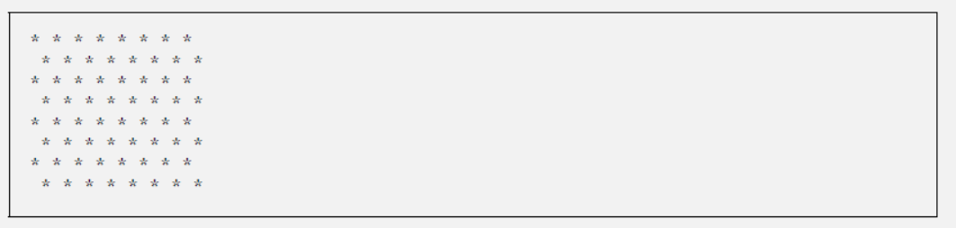
Ex 14
Write an application that displays a checkerboard pattern, as follows:

Slide 48
public class Checker {
public static void main( String args[] ) {
System.out.println( "* * * * * * * *" );
System.out.println( " * * * * * * * *" );
System.out.println( "* * * * * * * *" );
System.out.println( " * * * * * * * *" );
System.out.println( "* * * * * * * *" );
System.out.println( " * * * * * * * *" );
System.out.println( "* * * * * * * *" );
System.out.println( " * * * * * * * *" );
} // end main
} // end class Checker

Slide 49
Ex 15
Here’s a peek ahead. In this chapter, you have learned about integers and the type int. Java can also represent floating-point numbers that contain decimal points, such as 3.14159. Write an application that inputs from the user the radius of a circle as an integer and prints the circle’s diameter, circumference and area using thefloating-point value 3.14159 for π. Use the techniques shown in Fig. 2.7. [Note: You may also use the predefined constant Math.PI for the value of π. This constant is more precise than the value 3.14159. Class Math is defined in package java.lang. Classes in that package are imported automatically, so you do not need to import class Math to use it.] Use the following formulas (r is the radius): diameter = 2r circumference = 2πr area = πr 2 Do not store the results of each calculation in a variable. Rather, specify each calculation as the value that will be output in a System.out.printf statement. Note that the values produced by the circumference and area calculations are floating-point numbers. Such values can be output with the format specifier %f in a System.out.printf statement. You will learn more about floating-point numbers in Chapter 3.

Slide 50
import java.util.Scanner;
public class Circle {
public static void main( String args[] ) {
Scanner input = new Scanner( System.in );
int radius; // radius of circle
System.out.print( "Enter radius: " ); // prompt for input
radius = input.nextInt(); // read number
System.out.printf( "Diameter is %d\n", ( 2 * radius ) );
System.out.printf( "Area is %f\n", ( Math.PI * radius * radius ) );
System.out.printf( "Circumference is %f\n", ( 2 * Math.PI * radius ) );
} // end main
} // end class Circle

Slide 51
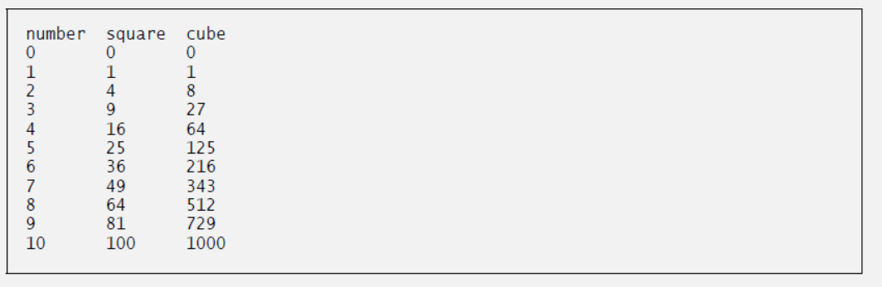
Ex 16
Using only the programming techniques you learned in this chapter, write an application that calculates the squares and cubes of the numbers from 0 to 10 and prints the resulting values in table format, as shown below. [Note: This program does not require any input from the user.]

Slide 52
public class Numbers {
public static void main( String args[] ) {
// print a header for the table
System.out.printf( "%s\t%s\t%s\n", "number", "square", "cube" );
// print x, x squared and x cubed for each value
int x = 0;
System.out.printf( "%d\t%d\t%d\n", x, ( x * x ), ( x * x * x ) );
x = 1;
System.out.printf( "%d\t%d\t%d\n", x, ( x * x ), ( x * x * x ) );
x = 2;
System.out.printf( "%d\t%d\t%d\n", x, ( x * x ), ( x * x * x ) );
x = 3;
System.out.printf( "%d\t%d\t%d\n", x, ( x * x ), ( x * x * x ) );
x = 4;
System.out.printf( "%d\t%d\t%d\n", x, ( x * x ), ( x * x * x ) );

Slide 53
x = 5;
System.out.printf( "%d\t%d\t%d\n", x, ( x * x ), ( x * x * x ) );
x = 6;
System.out.printf( "%d\t%d\t%d\n", x, ( x * x ), ( x * x * x ) );
x = 7;
System.out.printf( "%d\t%d\t%d\n", x, ( x * x ), ( x * x * x ) );
x = 8;
System.out.printf( "%d\t%d\t%d\n", x, ( x * x ), ( x * x * x ) );
x = 9;
System.out.printf( "%d\t%d\t%d\n", x, ( x * x ), ( x * x * x ) );
x = 10;
System.out.printf( "%d\t%d\t%d\n", x, ( x * x ), ( x * x * x ) );
} // end main
} // end class Numbers

Slide 54
Ex 17
Write a program that inputs five numbers and determines and prints the number of negative numbers input, the number of positive numbers input and the number of zeros input.

Slide 55
import java.util.Scanner;
public class Tally {
public static void main( String args[] ) {
Scanner input = new Scanner( System.in );
int inputNumber;
int zeroTally;
int positiveTally;
int negativeTally;
// initialize counters
zeroTally = 0;
positiveTally = 0;
negativeTally = 0;
System.out.print( "Enter first integer: " ); // prompt for input
inputNumber = input.nextInt(); // read first number
if ( inputNumber == 0 )
zeroTally = zeroTally + 1;
if ( inputNumber < 0 )
negativeTally = negativeTally + 1;
if ( inputNumber > 0 )
positiveTally = positiveTally + 1;
System.out.print( "Enter second integer: " ); // prompt for input 35 inputNumber = input.nextInt(); // read second number

Slide 56
if ( inputNumber == 0 )
zeroTally = zeroTally + 1;
if ( inputNumber < 0 )
negativeTally = negativeTally + 1;
if ( inputNumber > 0 )
positiveTally = positiveTally + 1;
System.out.print( "Enter third integer: " ); // prompt for input
inputNumber = input.nextInt(); // read third number
if ( inputNumber == 0 )
zeroTally = zeroTally + 1;
if ( inputNumber < 0 )
negativeTally = negativeTally + 1;
if ( inputNumber > 0 )
positiveTally = positiveTally + 1;
System.out.print( "Enter fourth integer: " ); // prompt for input
inputNumber = input.nextInt(); // read fourth number

Slide 57
if ( inputNumber == 0 )
zeroTally = zeroTally + 1;
if ( inputNumber < 0 )
negativeTally = negativeTally + 1;
if ( inputNumber > 0 )
positiveTally = positiveTally + 1;
System.out.print( "Enter fifth integer: " ); // prompt for input
inputNumber = input.nextInt(); // read fifth number
if ( inputNumber == 0 )
zeroTally = zeroTally + 1;
if ( inputNumber < 0 )
negativeTally = negativeTally + 1;
if ( inputNumber > 0 )
positiveTally = positiveTally + 1;
// create a string describing the results
System.out.printf( "\nThere are %d zeros\n", zeroTally );
System.out.printf( "There are %d positive numbers\n", positiveTally );
System.out.printf( "There are %d negative numbers\n", negativeTally );
} // end main
} // end class Tally

